Slide 1
GROUP 2 - Week 14
Notes:
Good Afternoon Professors and My Fellow Course Mates, my Name is Boon Jie from Group 2 and I will be your starting presenter for Group 2.

Slide 2
Table of Contents
02
04
Project Considerations
What is Float?
01
03
Background Information
Features Demo
Notes:
Here is the overview for our presentation today. We will be going through over some Background Information ,What Float is, a demo of the App Features and Project Considerations.

Slide 3
01
Background Information
Notes:
Ok so before I begin to explain what Float is, I would like to first go through some background information regarding what led us to develop this App, which is the issue regarding Mental Wellness.

Slide 4
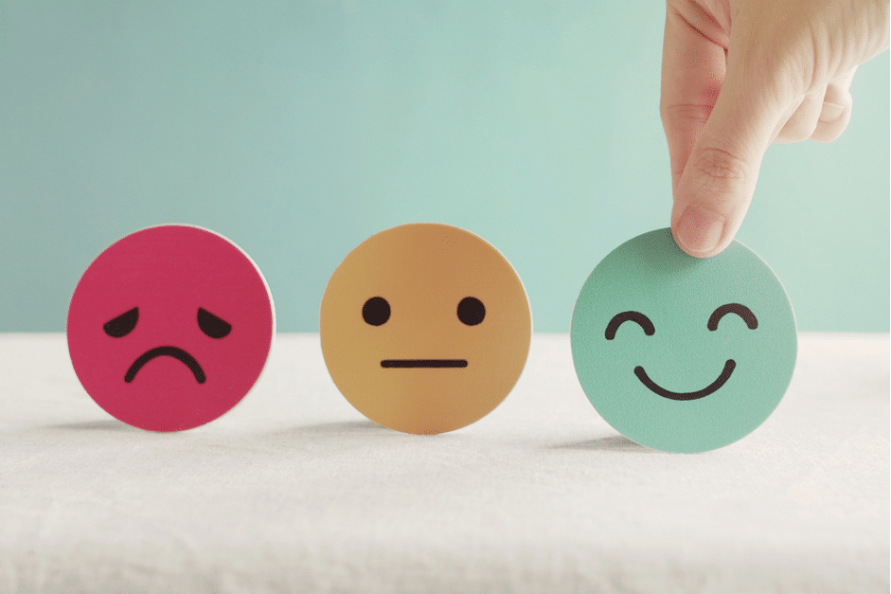
Notes:
So, what is Mental Wellness? According to the World Health Organisation (WHO), Mental Wellness is defined as a state of well-being in which the individual realises his or her own abilities and are able to cope with the normal stresses of life So, we now know what it is, but is there any way to measure it? Unfortunately, unless you go to specialized institutions, there’s very little means to go and quantify it. There’s no easily accessible and free way to check on one’s own Mental Wellness, and hence this is where the idea of Float came to be, which is to improve the overall mental wellness of our audience.

Slide 5
02
What is Float?
Notes:
Before I delve in further to explain what Float is exactly about, here is a short video showcasing our App.

Slide 6


Slide 7

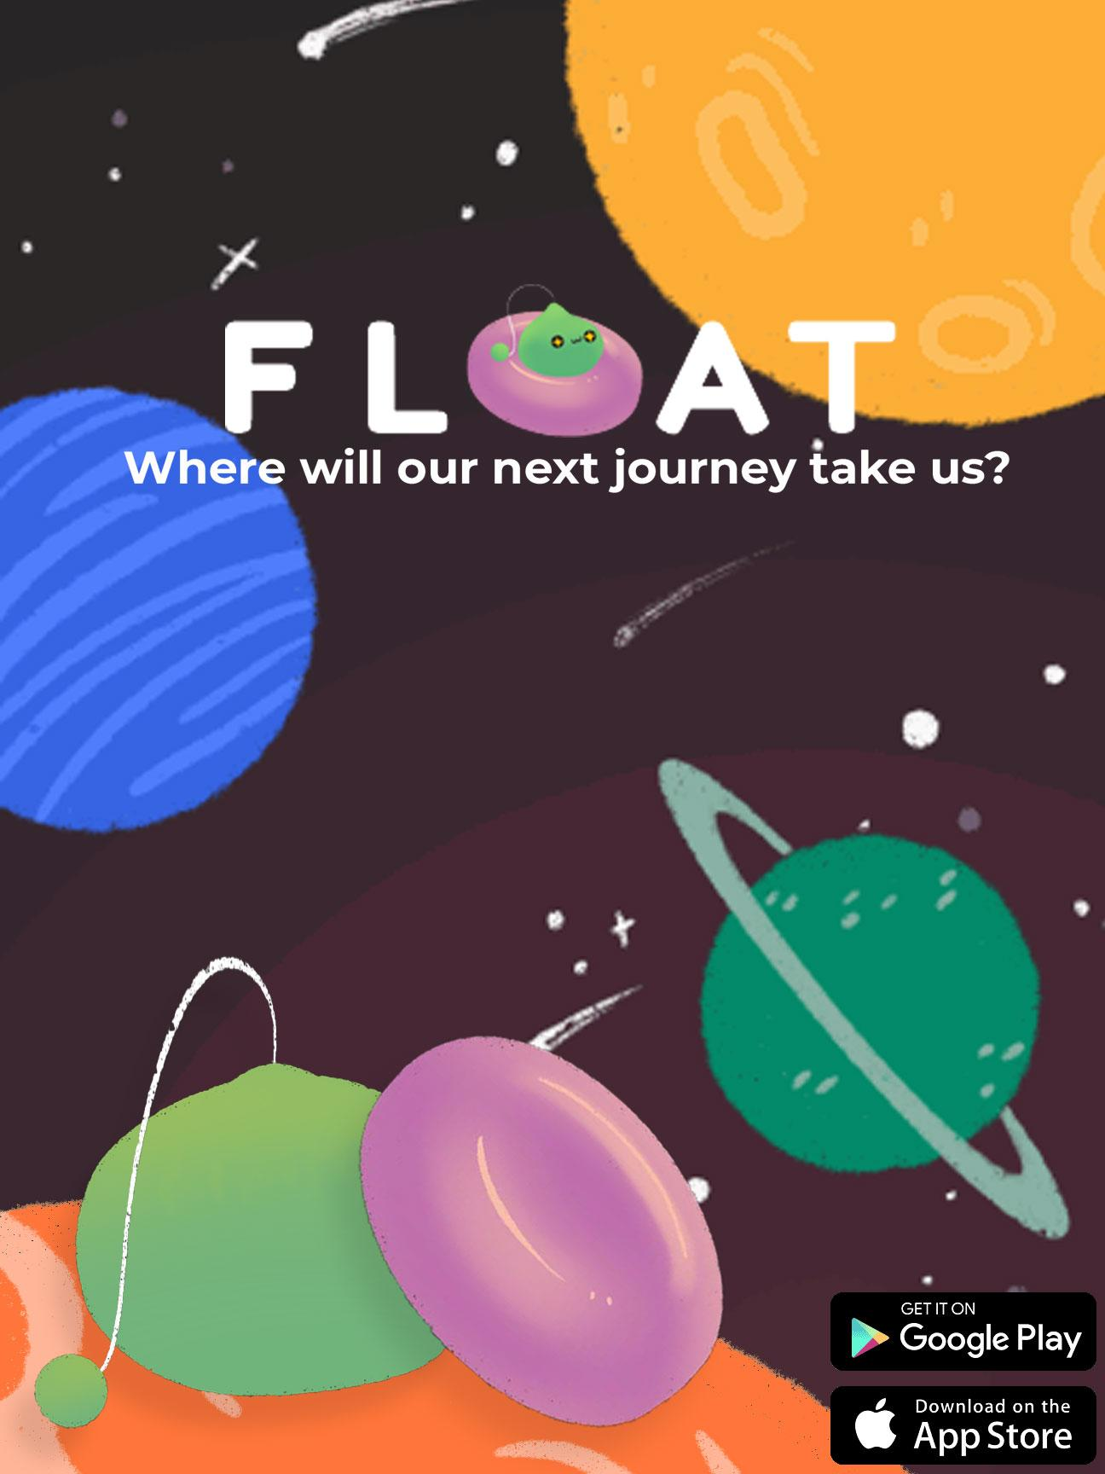
Notes:
As previously mentioned, the purpose of the Float app is to improve the overall mental wellness of our audience that is using it via various meaningful, interactive activities. We have chosen an Outer Space theme for our App, to emulate how vast and undiscovered our App is. With that as our premise, the User goes on a journey of self-discovery and enlightenment to Outer Space with the Avatar. The promotional poster shows the User looking forward to their next journey to an unknown destination, as highlighted by our jingle, “Where will our next journey take us?”.

Slide 8

Our Avatar / Mascot
Notes:
So you might be curious, why did we choose this style or design for our App in general? We have chosen to stick to a cuter UI to appeal more towards the younger generation. As for the Avatar, we decided on a non-humanoid mascot as it will be easier to work with to make it as visually appealing as possible throughout the App.

Slide 9
03
Demo
Notes:
Now Heriz will be taking over to show the demo of how the App works.

Slide 10

Demo Video
Notes:
Now Heriz will be taking over to show the demo of how the App works.

Slide 11
04
Project
Considerations
Notes:
Thank you Heriz.
As you have seen our mobile app demo. I hope it was interesting and I am sure some of you might have some questions about our projects. Hopefully, I will be able to answer them by going through some of the considerations our team have made during our project.

Slide 12

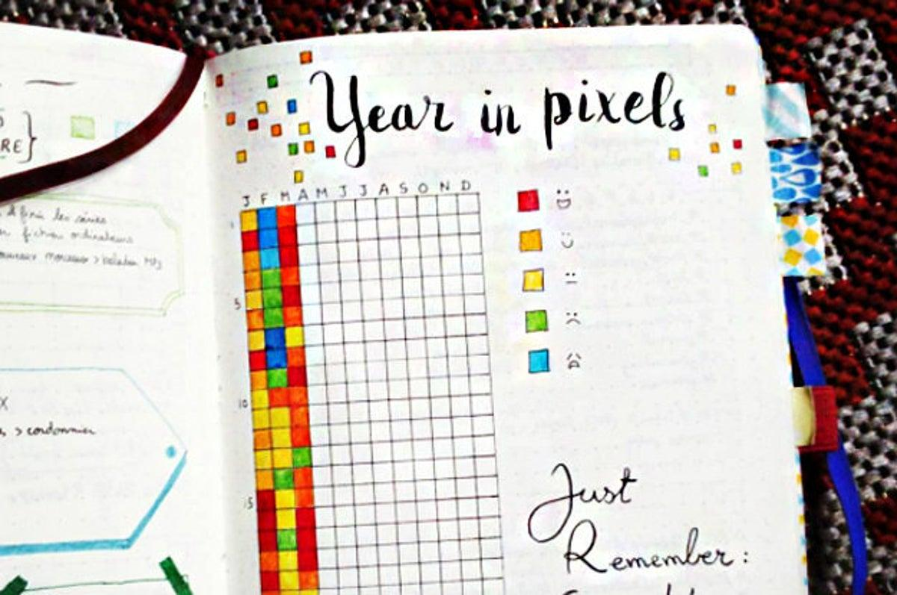
Objective
Coping mechanisms suggestions
Mental wellness metrics
Notes:
First and foremost, our team has collectively decided that our app should aim accomplish two objectives. One, is to provide coping mechanisms with suggestions to get user started on their mental wellness journey. Two, is to provide meaningful mental wellness metric. Allow me elaborate more on this. Time and time again I have heard from individuals lamenting about their stresses and the vicious cycle they create in their head. I understand it can be quite disorienting for people so see no meaningful progress even when they are putting in the work and effort toward their mental health. I am sure that some of you might think that this is feeding into the issue.
The key point i would like to point out is that this tracking metric is actually an accurate method to identify individuals whose mental issue require professional help.

Slide 13
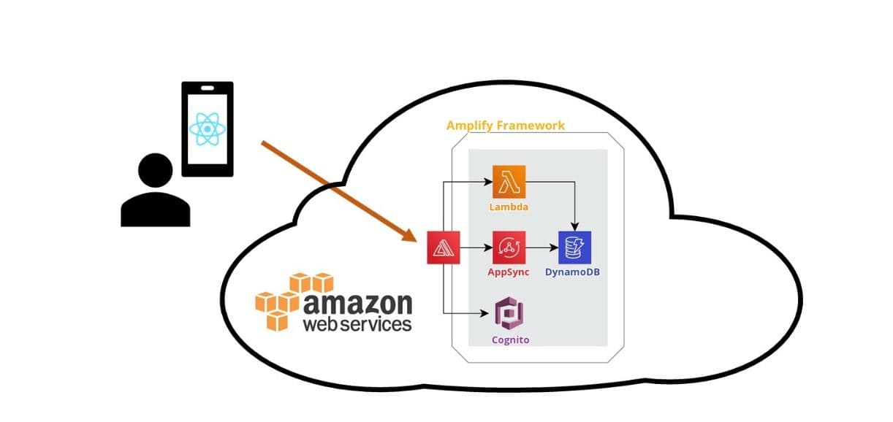
System Architecture

Slide 14
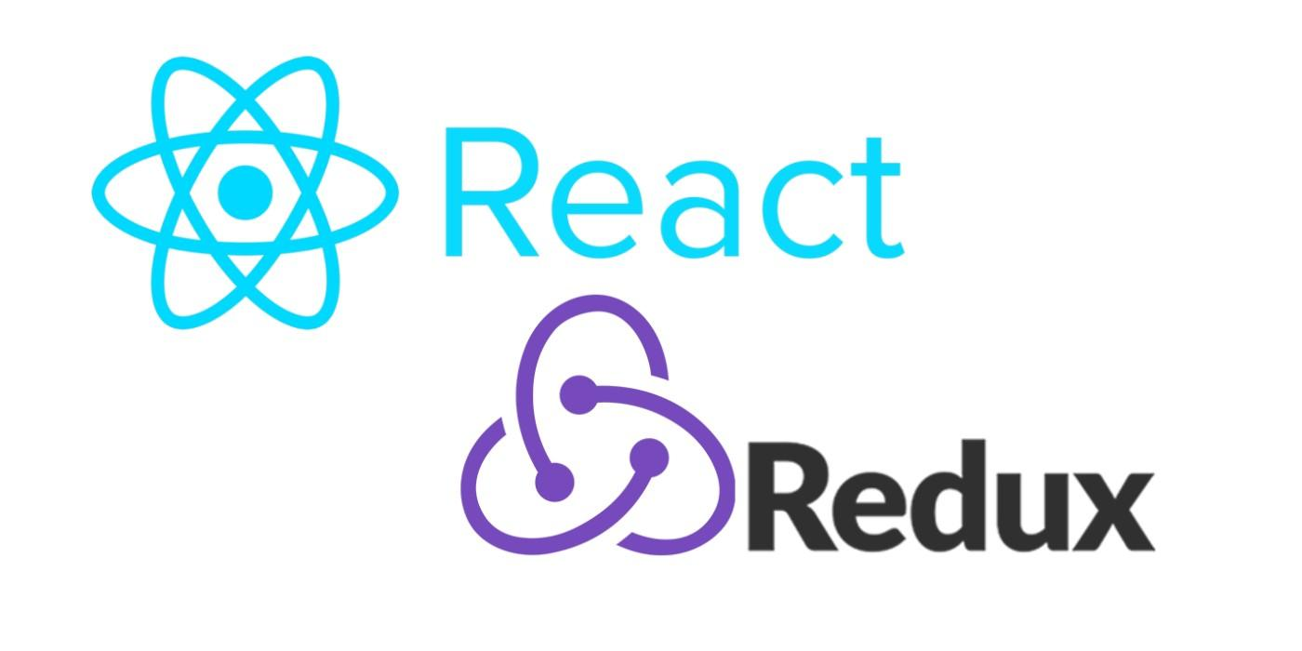
React redux
The state management
Notes:
Now comes the technical constraints we had to content with. Generally speaking, most programmers say without understanding, “Don’t use global variables”. However, what is so bad about using global states? Very briefly, it makes the program state unpredictable. Imagine a couple of object using the same variable and there is no randomness. If one of the methods triggers a side effect which changes the global state. You would then no longer know the starting state and can no longer predict the output and therefore can’t test it. Furthermore, global state hurts readability of your code. If your code has external dependency that isn’t explicitly introduced into the code then whoever gets the job of maintaining your code will have to go looking for it to figure out where it came from. We know is bad to abuse it but there useful situation to use it. For our project, it is used for keeping track whether user is authenticated. Would you not agree this having a way to check if user is authenticated globally would be a useful information? In this case, I don’t see any good solutions without Redux. Simply, put it would be quite cumbersome to implement an alternate solution.
Imagine how an app always know the latest data or having consistent state throughout the app. With redux state management, we can keep track of the app data without the need of continuously calling the backend for database. This is also used for keeping track whether the user has signed in and is authenticated or not so only legitimate user can access the functionalities of our app.

Slide 15

AWS Amplify
Notes:
So, why did we decide to use AWS as our backend. The predominant reason is the cost of development. To put into perspective, the cost of development on building on a serverless architecture for project Float USD$2.11 for the month of october.
I am sure you could money pinch and play trick to turn off and on your backend but i did not want to do that. Just imagine the chaos when I decided to turn the backend when my team is building the app then i go to sleep. Fun times
Disregarding the cost, AWS Amplify provides a set of purpose-built tools to make development easier. AWS DynamoDB is also well suited for mobile applications because it is designed for high-scale use cases where consistent performance is critical as an application grows.

Slide 16

Thank you!
Do you have any questions?
Notes:
With that, I believe I have given a good rundown some of the constraint our team faced during the project.Do you have any questions?

